Slide 1
HUMAN COMPUTER INTERACTION
LECTURE 1

Slide 2
Introduction to HCI
DEFINITIONS
Definition 1 - HCI is the study and practice of usability – It is about understanding and creating software, other technology that people will want to use, will be able to use and will find effective when used.
Usability is one of the key concepts in HCI. It is concerned with making systems easy to learn and use. A usable system is:
easy to learn
easy to remember how to use
effective to use
efficient to use
safe to use
enjoyable to use

Slide 3
“A usable software is one that supports the effective and efficient completion of tasks in given work context”
Benefits of more usable software to users include
Increased productivity
Increased accuracy of data input and interpretation
Decreased user errors
Decreased user training and cost
Decreased need for ongoing technical support.

Slide 4
Definition 2 – HCI is the study of how people use computer systems to perform certain tasks – HCI tries to provide us with all understanding of the computer and the person using it, so as to make the interaction between them more effective.
Definition 3 – HCI concerns with process of design, evaluation and implementation of interactive computing systems for human use, plus the study of major phenomena surrounding them.
Importance of HCI – HCI will be increasingly important in following areas
As a part of software development process and system design methods.
As a part of future legal requirements for software.
As the basis for a set of usability criteria to evaluate and choose from competing products.
As the basis for successful marketing strategy to small business user.

Slide 5
The Goals of HCI
The goals of HCI are to produce usable and safe systems, as well as functional systems. In order o produce computer systems with good usability.
Developers must attempt to:
understand the factors that determine how people use technology
develop tools and techniques to enable building suitable systems
achieve efficient, effective, and safe interaction
put people first
Underlying the whole theme of HCI is the belief that people using a computer system should come first. Their needs, capabilities and preferences for conducting various tasks should direct developers in the way that they design systems. People should not have to change the way that they use a system in order to fit in with it. Instead, the system should be designed to match their requirements.

Slide 6
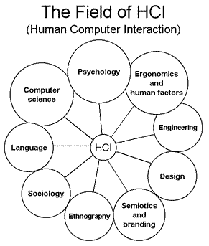

Slide 7
Disciplines contributing to HCI
The field of HCI covers a wide range of topics, and its development has relied on contributions from many disciplines.
Some of the main disciplines which have contributed to HCI are:
Computer Science Technology, Software design, development & maintenance, User Interface Management Systems (UIMS) & User Interface Development Environments (UIDE), Prototyping tools, Graphics.
Cognitive Psychology Information processing, Capabilities, Limitations, Cooperative working, Performance prediction.

Slide 8
Social Psychology Social & organizational structures
Ergonomics/Human Factors Hardware design Display readability
Linguistics Natural language interfaces
Artificial Intelligence Intelligent software
Philosophy, Sociology & Anthropology Computer supported cooperative work (CSCW)
Engineering & Design Graphic design, Engineering principles

Slide 9
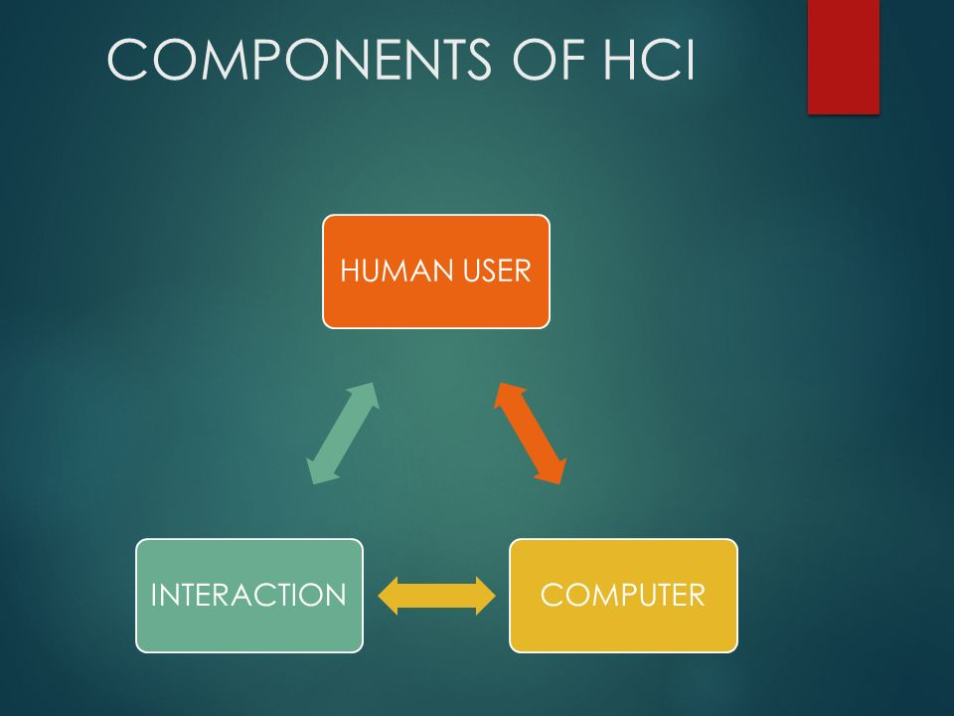

Slide 10
Human – are good at sensing low level stimuli, pattern recognition, inductive reasoning, multiple strategies, adapting to hard things.
Computers – good at counting and measuring, accurate storage and recall, rapid and consistent responses, data processing, repetitive actions.
Interaction – The list of skills making humans to do what humans do best and computers to do their task.

Slide 11
User(Human)
By user we may mean an individual user, a group of users working together, or a sequence of users in an organization, each dealing with some part of the task or process. The user is whoever is trying to get the job done using the technology.
The human is the central character in any discussion of interactive systems. The requirements of the user should therefore be our first priority.
Study of the human psychology is the basic for HCI. This may seem inappropriate for designing and building interactive systems but it is not.
In order to design something for someone understanding of their capabilities and limitations is a must. There is need to find if there are things that they will find difficult or even impossible.
This understanding helps in encouraging which people feel more comfortable.

Slide 12
The study of psychology involves how humans perceive the world around them, how they store and process information and solve problems.
For this study there are many models which were proposed earlier such as “Model human processor” which is a simplified view of the human processing involved in interaction with computer systems.
Model human processor
The model comprises three subsystems
1.The perceptual system- handling sensory stimulus from the outside world.
2.The motor system which controls actions.
3.The cognitive system which provides the processing needed to connect the two

Slide 13
Each of these subsystems has its own processor and memory, although the complexity of these varies depends upon the tasks the system has to perform.
The model also includes a member of principles of operation which dictate the behavior of the system under certain conditions.
The study needed for HCI is done by treating user as an information processing system , by comparing with conventional computer system.
Information comes in , is stored and processed, and information is passed out.

Slide 14
Therefore the study focuses on three components of the system as
Input-output channels
Memory
Processing
In the study of human, we are dealing with an intelligent information processing system, and therefore it includes problem solving , learning and making mistakes.
The human, unlike the computer is also influenced by external factors such as the social and organizational environment and there is need to be aware of these influences.

